Slide 1
Clustering – Part 3
Density Based Clustering
Prof. Navneet Goyal
BITS, Pilani
Notes:
Dr. Navneet Goyal, BITS,Pilani

Slide 2
Density-based Clustering
  Based on connectivity and density functions
  Filter out noise, find clusters of arbitrary shape
Notes:
Dr. Navneet Goyal, BITS,Pilani

Slide 3
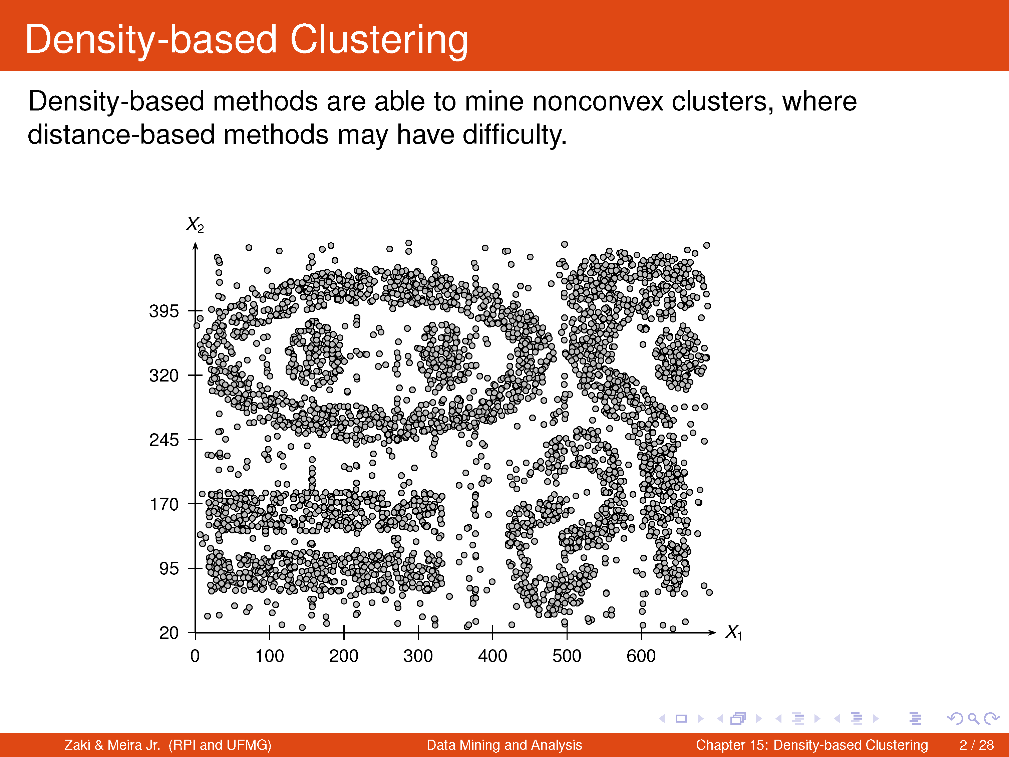

Slide 4
Density-Based Clustering Methods
Major features:
  Discover clusters of arbitrary shape
  Handle noise
  One scan
  Need density parameters as termination condition
Several interesting studies:
  DBSCAN: Ester, et al. (KDD’96)
  OPTICS: Ankerst, et al (SIGMOD’99).
  DENCLUE: Hinneburg & D. Keim (KDD’98)
  CLIQUE: Agrawal, et al. (SIGMOD’98)
Notes:
Dr. Navneet Goyal, BITS,Pilani

Slide 5
Density-Based Method: DBSCAN
Density-Based Spatial Clustering of Applications with Noise
Clusters are dense regions of objects separated by regions of low density ( noise)
Outliers will not effect creation of cluster
Input
  MinPts – minimum number of points in any cluster
  Eps – for each point in cluster there must be another point in it less than this distance away
Notes:
Dr. Navneet Goyal, BITS,Pilani

Slide 6
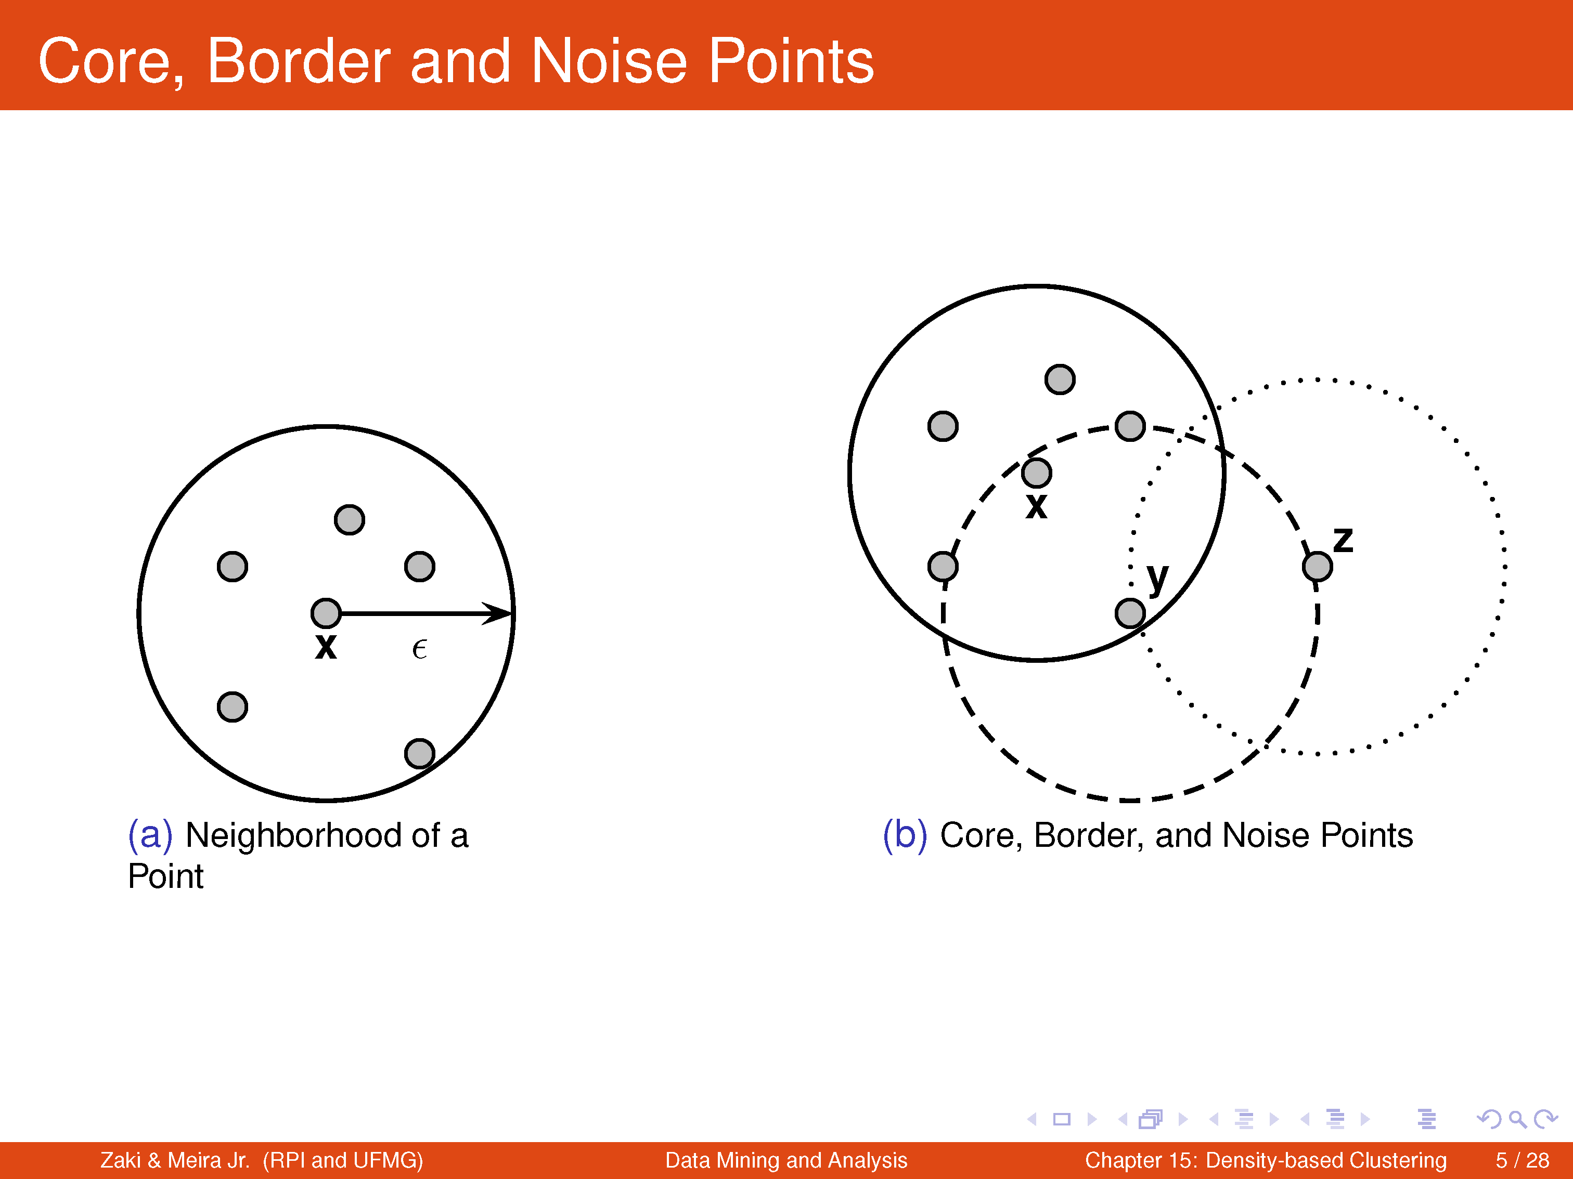

Slide 7
DBSCAN Density Concepts
Eps-neighborhood: Points within Eps distance of a point.
Core point: Eps-neighborhood dense enough (MinPts)
Directly density-reachable: A point p is directly density-reachable from a point q if the distance is small (Eps) and q is a core point.
Density-reachable: A point is density-reachable form another point if there is a path from one to the other consisting of only core points.
Notes:
Dr. Navneet Goyal, BITS,Pilani

Slide 8
Density-Based Method: DBSCAN
Eps-neighborhood: Points within Eps distance of a point.
N_{Eps}(p): {q belongs to D | dist(p,q) <= Eps}
Core point: Eps-neighborhood dense enough (MinPts)
Directly density-reachable: A point p is directly density-reachable from a point q if the distance is small (Eps) and q is a core point.
Directly density-reachable: A point p is directly density-reachable from a point q wrt. Eps, MinPts if
1) p belongs to N_{Eps}(q)
  2) core point condition:
  |N_{Eps} (q)| >= MinPts
p
MinPts = 5
Eps = 1 cm
q
Notes:
Dr. Navneet Goyal, BITS,Pilani

Slide 9
Density-Based Method: DBSCAN
Density-reachable: A point is density-reachable form another point if there is a path from one to the other consisting of only core points
  A point p is density-reachable from a point q wrt. Eps, MinPts if there is a chain of points p₁, …, p_{n}, p₁ = q, p_{n} = p such that p_{i+1} is directly density-reachable from p_{i} for all i (1,n-1)
p
p₁
q
Notes:
Dr. Navneet Goyal, BITS,Pilani

Slide 10
Density-Based Method: DBSCAN
Density-connected
  A point p is density-connected to a point q wrt. Eps, MinPts if there is a point o such that both, p and q are density-reachable from o wrt. Eps and MinPts.
p
q
o
Notes:
Dr. Navneet Goyal, BITS,Pilani

Slide 11
DBSCAN
Relies on a density-based notion of cluster: A cluster is defined as a maximal set of density-connected points
Outlier
Border
Eps = 1cm
MinPts = 5
Core
Notes:
Dr. Navneet Goyal, BITS,Pilani

Slide 12

DBSCAN: Core, Border, and Noise Points
Notes:
Dr. Navneet Goyal, BITS,Pilani

Slide 13
DBSCAN: The Algorithm
  Label all points as core, border, or noise points
  Eliminate noise points
  Put an edge between all core points that are within ε of each other
  Make each group of connected core points into a separate cluster
  Assign each border point to one of the its associated core point
Notes:
Dr. Navneet Goyal, BITS,Pilani

Slide 14


DBSCAN: Core, Border and Noise Points
Original Points
Point types: core, border and noise
Eps = 10, MinPts = 4
Source of figure: Introduction to Data Mining by Tan et. al.
Notes:
Dr. Navneet Goyal, BITS,Pilani

Slide 15

When DBSCAN Works Well
Original Points
Clusters
Resistant to Noise
Can handle clusters of different shapes and sizes
Source of figure: Introduction to Data Mining by Tan et. al.
Notes:
Dr. Navneet Goyal, BITS,Pilani

Slide 16



When DBSCAN Does NOT Work Well
(MinPts=4, Eps=9.75).
Original Points
Varying densities
High-dimensional data
(MinPts=4, Eps=9.92)
Source of figure: Introduction to Data Mining by Tan et. al.
Notes:
Dr. Navneet Goyal, BITS,Pilani

Slide 17
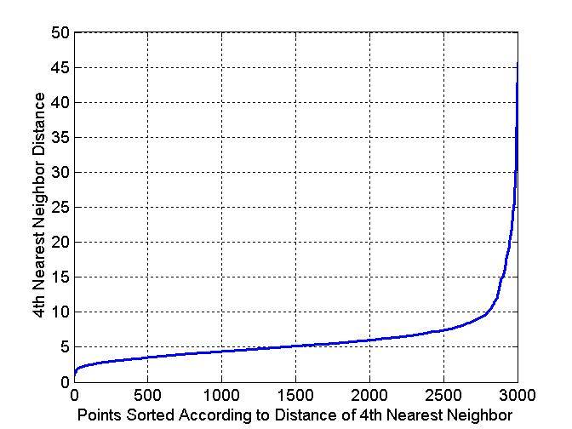
DBSCAN: Determining EPS and MinPts
Idea is that for points in a cluster, their k^{th} nearest neighbors are at roughly the same distance
Noise points have the k^{th} nearest neighbor at farther distance
So, plot sorted distance of every point to its k^{th} nearest neighbor
Eps=10
Minpts=4
Source of figure: Introduction to Data Mining by Tan et. al.

Slide 18
OPTICS: Self Study
Ordering Points To Identify Clustering Structure
DBSCAN is sensitive to the choice of input parameters
Parameter setting is done empirically
High dimensional data – more pronounced
High dimensional data clustering structures are not generally characterized by global density parameters like eps & minpts
OPTICS as a solution!
Notes:
Dr. Navneet Goyal, BITS,Pilani

Slide 19
OPTICS
Computes an augmented cluster ordering
Ordering represents the density based clustering structure of the data
Contains information that is equivalent to density based clustering obtained from a wide range of parameter settings
Cluster ordering can be used to extract basic clustering information
Notes:
Dr. Navneet Goyal, BITS,Pilani

Slide 20
OPTICS
In DBSCAN, for constant minpts, clusters with high density (lower eps) are completely contained in density connected sets obtained with lower density
Extend DBSCAN to process a set of distance parameter eps at the same time.
For this the objects need to be processed in a specific order
This order selects an object that is density reachable wrt lowest eps so that clusters of higher density will be finished first.
Notes:
Dr. Navneet Goyal, BITS,Pilani

Slide 21
OPTICS
2 values need to be stored for each object:
  Core distance
  Reachability distance
Core distance – smallest eps that makes it a core object. If p is not core, it is iundefined.
Reachability distance of q wrt p is the greater value of the core distance of p and the euclidean distance between p & q. If p is not a core object, distance reachability bet p & q is undefined
Notes:
Dr. Navneet Goyal, BITS,Pilani

Slide 22
Some Research Directions
Ensemble Clustering
Parallelizing Clustering Algorithms to leverage a Cluster
Notes:
Dr. Navneet Goyal, BITS,Pilani

Slide 23
Ensemble Clustering
Similar to Ensemble Classification
Consensus Clustering
Obtain different clustering solutions and then reconcile them

Slide 24
Parallelizing Clustering Algorithms
Parallelize to leverage a cluster
Two levels of parallelism
  Node Level
  Core Level
Not Necessarily Orthogonal
Hybrid – Non Trivial
Programming Environment:
  MPI
  Open MP
Notes:
Dr. Navneet Goyal, BITS,Pilani

